Slide 1
Presentation semester project IIG
Timeline idea
Dataset creation
FACS
EMFACS
CK+
BP-D4
Blend shapes
Blend shapes – AUs mapping
References

Slide 2
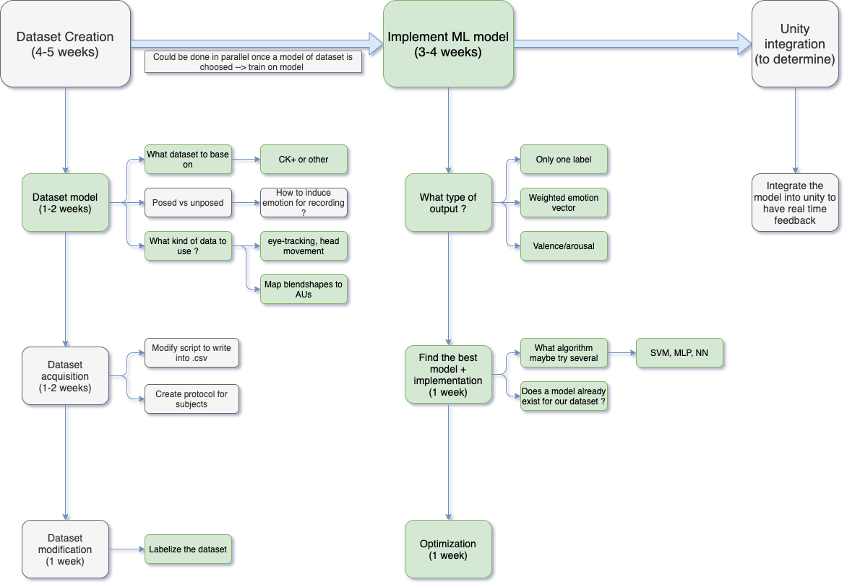
Timeline idea

Slide 3
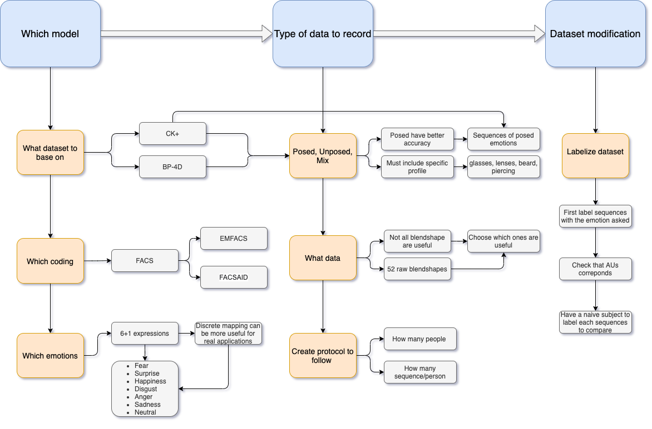
Dataset creation

Slide 4
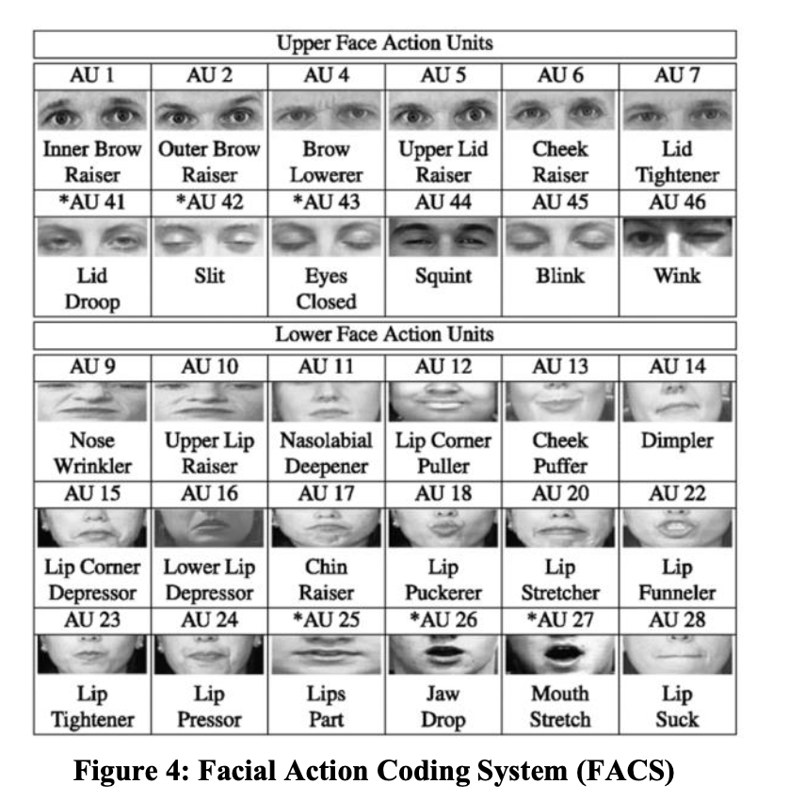
Facial Action Coding System (FACS)
Beh Mei Yin, Delina & Omar, Shariman & A. Talip, Bazilah & Mukhlas, Amalia & Norain, Nur & Othman, Abu Talib. (2017).
Fusion of face recognition and facial expression detection for authentication: a proposed model

Slide 5
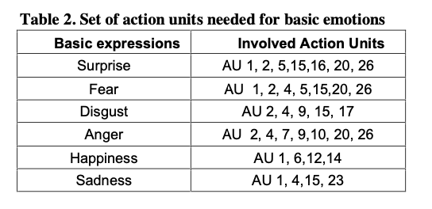
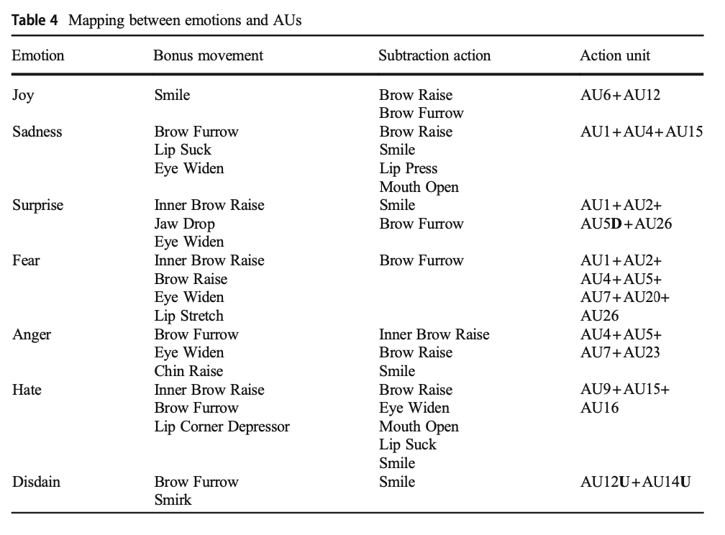
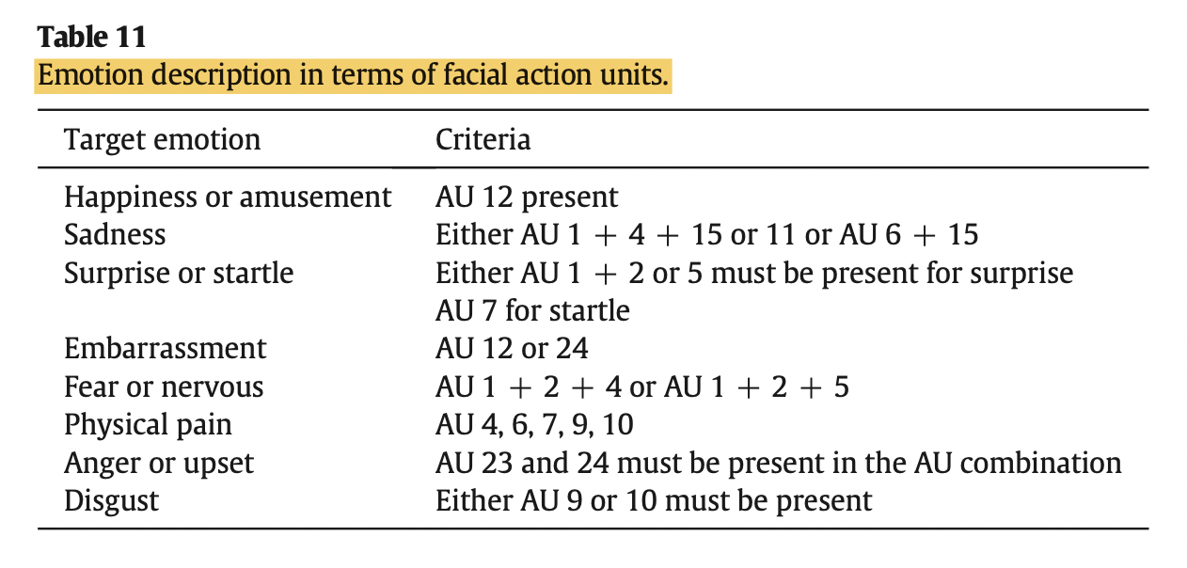
Selection of AUs for emotion recognition
Ghayoumi, Mehdi & Bansal, Arvind. (2016).
Unifying Geometric Features and Facial Action Units for Improved Performance of Facial Expression Analysis.
​
Yao, L., Wan, Y., Ni, H. et al.
Action unit classification for facial expression recognition using active learning and SVM
Xing Zhang, Lijun Yin, Jeffrey F. Cohn, Shaun Canavan, Michael Reale, Andy Horowitz, Peng Liu, Jeffrey M. Girard,
BP4D-Spontaneous: a high-resolution spontaneous 3D dynamic facial expression database,
Image and Vision Computing

Slide 6
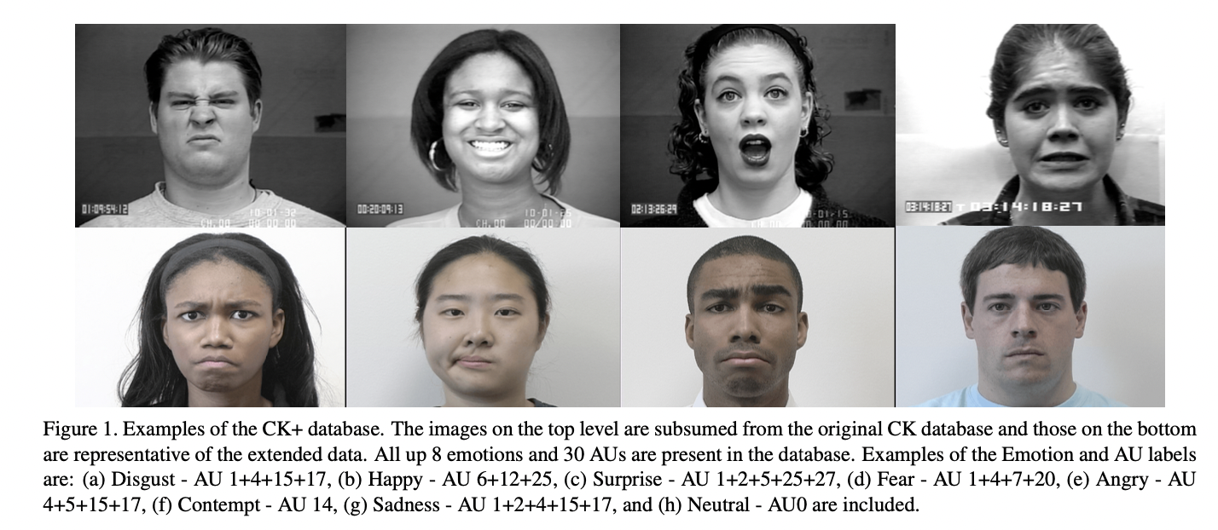
CK+ dataset
Particularities
7 emotions
Anger
Contempt
Disgust
Fear
Happy
Sadness
Surprise
Posed expressions (+ unposed smile for CK+)
Manually FACS coded
Most used dataset (reliable)
Posed expressions
Protocol
P. Lucey, J. F. Cohn, T. Kanade, J. Saragih, Z. Ambadar and I. Matthews,
"The Extended Cohn-Kanade Dataset (CK+): A complete dataset for action unit
and emotion-specified expression”
People are asked to express and emotion (recorded)
Neutral to apex sequences

Slide 7
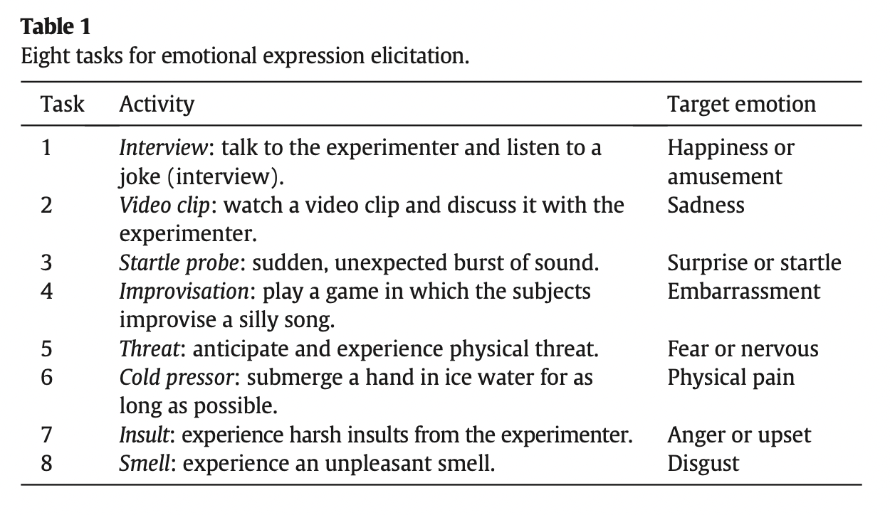
BP-D4 dataset
Particularities
How to induce spontaneous emotion
8 emotions
Anger
Disgust
Embarrassment
Fear
Happy
Pain
Sadness
surprise
Unposed expressions (spontaneous)
Unposed more representative of reality
Manually FACS coded
Less used
Difficult to implement in this project
Xing Zhang, Lijun Yin, Jeffrey F. Cohn, Shaun Canavan, Michael Reale, Andy Horowitz, Peng Liu, Jeffrey M. Girard,
BP4D-Spontaneous: a high-resolution spontaneous 3D dynamic facial expression database,
Image and Vision Computing,

Slide 8
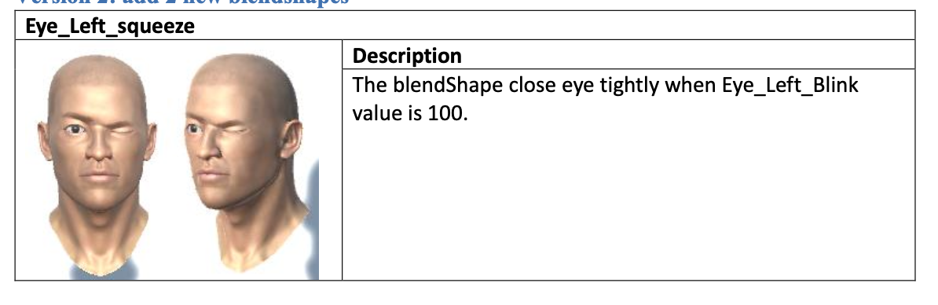
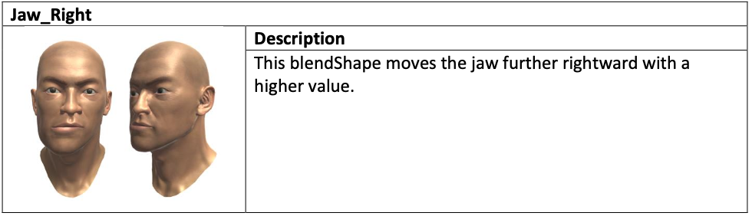
Blendshapes
Eye_Right_Down
Eye_Left_Wide
.
.
.
.
.
.
Eye_Left_squeeze
.
.
Jaw_Right
.
.
.
.
.
.
Mouth_Smile_Left
Mouth_Sad_Left
38 lips blend shapes (37+1 no detect)
14 eyes blend shape
52 blend shapes in total

Slide 9
Mapping selected AU to Blend shape
AUs | AUs Definition | corresponding Blend shapes | Blendshapes definitions | Comments
AU 1 | Inner Brow Raiser | Eye_Left_Up and Eye_Right_Up | Influences the muscles around the eye, moving these muscles further upward with a higher value. | /
AU 2 | Outer Brow Raiser | Eye_Right_Left or Eye_Left_Left | influences the muscles around the left eye, moving these muscles further lef/rightward with a higher value. | /
AU 4 | Brow Lowerer | Eye_Left_Down and Eye_Right_Down | influences the muscles around the left eye, moving these muscles further downward with a higher value. | /
AU 5 | Upper Lid Raiser | Eye_Left_Wide and Eye_Right_Wide | open avatar’s right eye wide, it should be done when Eye_Blink_Right = 0. | /
AU 6 | Cheek Raiser | / | / | /
AU 7 | Lid Tightener | Eye_Left_Blink and Eye_Right_Blink | influences blinking of the left eye, closing it further with a higher value. | determine value (not 100%)

Slide 10
AU 9 | Nose Wrinkler | / | / | showed by AU10
AU 10 | Upper Lip Raiser | Mouth_UpperRight_Up + Mouth_UpperLeft_Up | Lowers the left/right upper lip further with a higher value. | /
AU 12 | Lip Corner Puller | Mouth_Smile_Right and Mouth_Smile_Left | raises the left/right side of the mouth further with a higher value. | /
AU 14 | Dimpler | / | / | /
AU 15 | Lip Corner Depressor | Mouth_Sad_Right and Mouth_Sad_Left | lowers the left/right side of the mouth further with a higher value. | /
AU 16 | Lower Lip Depressor | Mouth_Lower_DownRight and Mouth_Lower_DownLeft | lowers the left/right lower lip further with a higher value. | /
AU 17 | Chin Raiser | Mouth_Lower_Overlay | stretches the lower lip further and lays it on the upper lip further with a higher value. | not really accurate
AU 20 | Lip stretcher | / | / | /
AU 23 | Lip Tightener | Mouth_Pout | allows the lips to pout more with a higher value. | not really accurate
AU 26 | Jaw Drop | Jaw_Open | opens the mouth further with the higher value. | determine value (not 100%)

Slide 11
References
Beh Mei Yin, Delina & Omar, Shariman & A. Talip, Bazilah & Mukhlas, Amalia & Norain, Nur & Othman, Abu Talib. (2017). Fusion of face recognition and facial expression detection for authentication: a proposed model. 1-8. 10.1145/3022227.3022247.
Ghayoumi, Mehdi & Bansal, Arvind. (2016). Unifying Geometric Features and Facial Action Units for Improved Performance of Facial Expression Analysis.
Zhang, Xing & Yin, Lijun & Cohn, Jeffrey & Canavan, Shaun & Reale, Michael & Horowitz, Andy & Liu, Peng & Girard, Jeffrey. (2014). BP4D-Spontaneous: A high-resolution spontaneous 3D dynamic facial expression database. Image and Vision Computing. 32. 692-706. 10.1016/j.imavis.2014.06.002.
Yao, Li & Wan, Yan & Ni, Hongjie & Xu, Bugao. (2021). Action unit classification for facial expression recognition using active learning and SVM. Multimedia Tools and Applications. 80. 10.1007/s11042-021-10836-w.
Lucey, Patrick & Cohn, Jeffrey & Kanade, Takeo & Saragih, Jason & Ambadar, Zara & Matthews, Iain. (2010). The Extended Cohn-Kanade Dataset (CK+): A complete dataset for action unit and emotion-specified expression. 2010 IEEE Computer Society Conference on Computer Vision and Pattern Recognition - Workshops, CVPRW 2010. 94 - 101. 10.1109/CVPRW.2010.5543262.
Zhang, Xing & Yin, Lijun & Cohn, Jeffrey & Canavan, Shaun & Reale, Michael & Horowitz, Andy & Liu, Peng & Girard, Jeffrey. (2014). BP4D-Spontaneous: A high-resolution spontaneous 3D dynamic facial expression database. Image and Vision Computing. 32. 692-706. 10.1016/j.imavis.2014.06.002.
M. Pantic, M. Valstar, R. Rademaker and L. Maat, "Web-based database for facial expression analysis," 2005 IEEE International Conference on Multimedia and Expo, 2005, pp. 5 pp.-, doi: 10.1109/ICME.2005.1521424.
Facial Action Coding System (FACS) – A Visual Guidebook, https://imotions.com/blog/facial-action-coding-system

